Slide 1
Self Determination and Service Providers: Advocating Through Life’s Journeys 2023 Family Café
Taylor N. Hatch
Director

Slide 2
Introductions
Sara Canali – Self-advocate
Rebecca Crosby, MSW, CHWC – Self-advocate
Robyn Stawski – Self-advocate
Nichole Dawkins – Waiver Support Coordinator (WSC) Supervisor and Consumer-Directed Care Plus (CDC+) Consultant Supervisor
Natalie Jean, Moderator - Self-advocate and APD Ombudsman

Slide 3
Agenda
Self-determination and Self-advocacy
Insights and Experiences
Getting Connected

Slide 4
Flexibility and Self-Direction
Services can change and evolve – it is a dynamic process
Know the program rules so that you can utilize the flexibility – ask questions and be persistent
Use all available resources – iBudget Florida/CDC+ is the payor of last resort
You must ADVOCATE for yourself

Slide 5
Self-Advocacy
Explain how and what
- Explain what is going on inside your body
- You are the one living it
- Explain or show what you mean
- Explain WHY it is important
Educate providers on your needs and preferences
Find creative ways to connect with people or locate information

Slide 6
Self-Advocacy
Work closely with your Waiver Support Coordinator (WSC) – the WSC is there to support you!
Build relationships with your local APD office and the community
Use community resources that are available to everyone!

Slide 7
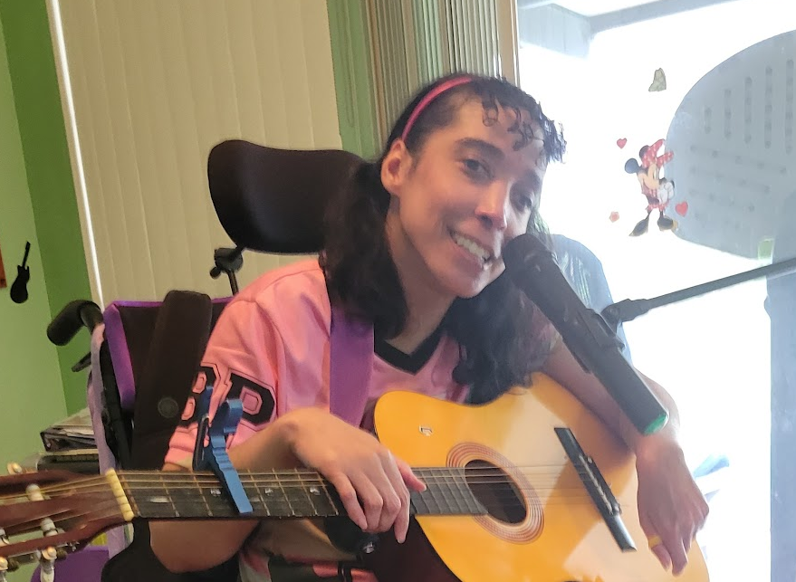
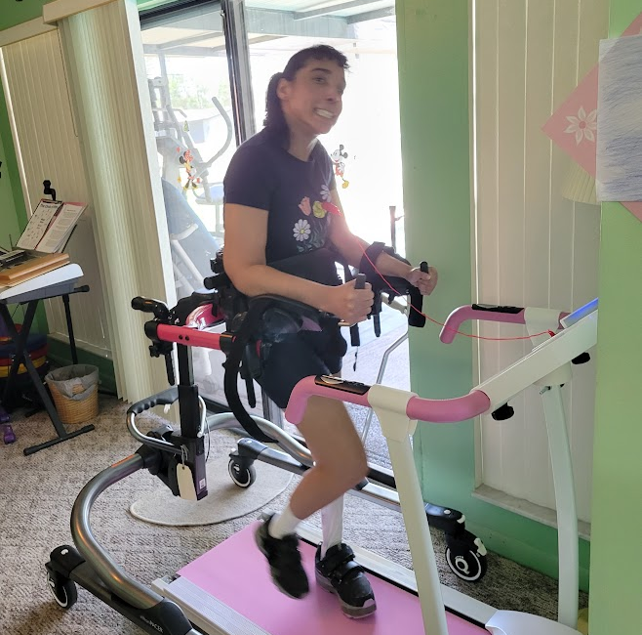
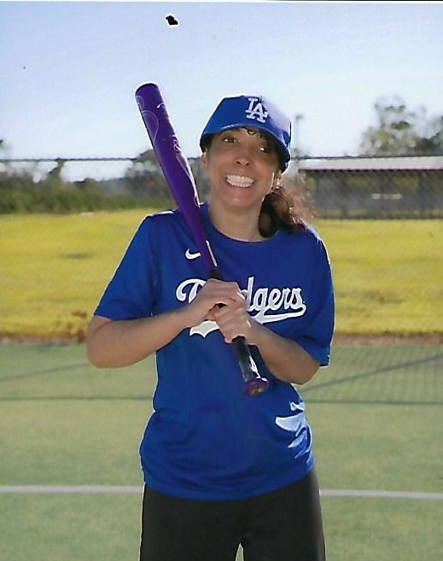
Meet Sara!

Slide 8
Sara’s Perspective
What new life celebrations and challenges have I had this year?
How has my life changed?
What is my role as my own CDC+ Representative?
What qualities do I look for in a provider?
How do I speak up for what I need?

Slide 9
Sara’s Perspective
What creative ways have I found success?
How do I make sure my providers are professional and responsible?
What strategies do I use to participate in the community?
Why did I move to CDC+?
My advice to you…

Slide 10
Meet
Rebecca!

Slide 11
Rebecca’s Perspective
What does a day in my life look like, and how do I navigate the challenges that arise?
How do I find resources in unexpected places?
What are green flags and red flags that I look for when interviewing providers?
What would my dream team of support look like as a combination of family, friends, and waiver providers?

Slide 12
Rebecca’s Perspective
When should I compromise?
When is it acceptable to use the word NO as a complete sentence?
What strategies do I use to make things run smoothly both in my home and in my community?
It’s important to make connections and be an ally because…

Slide 13
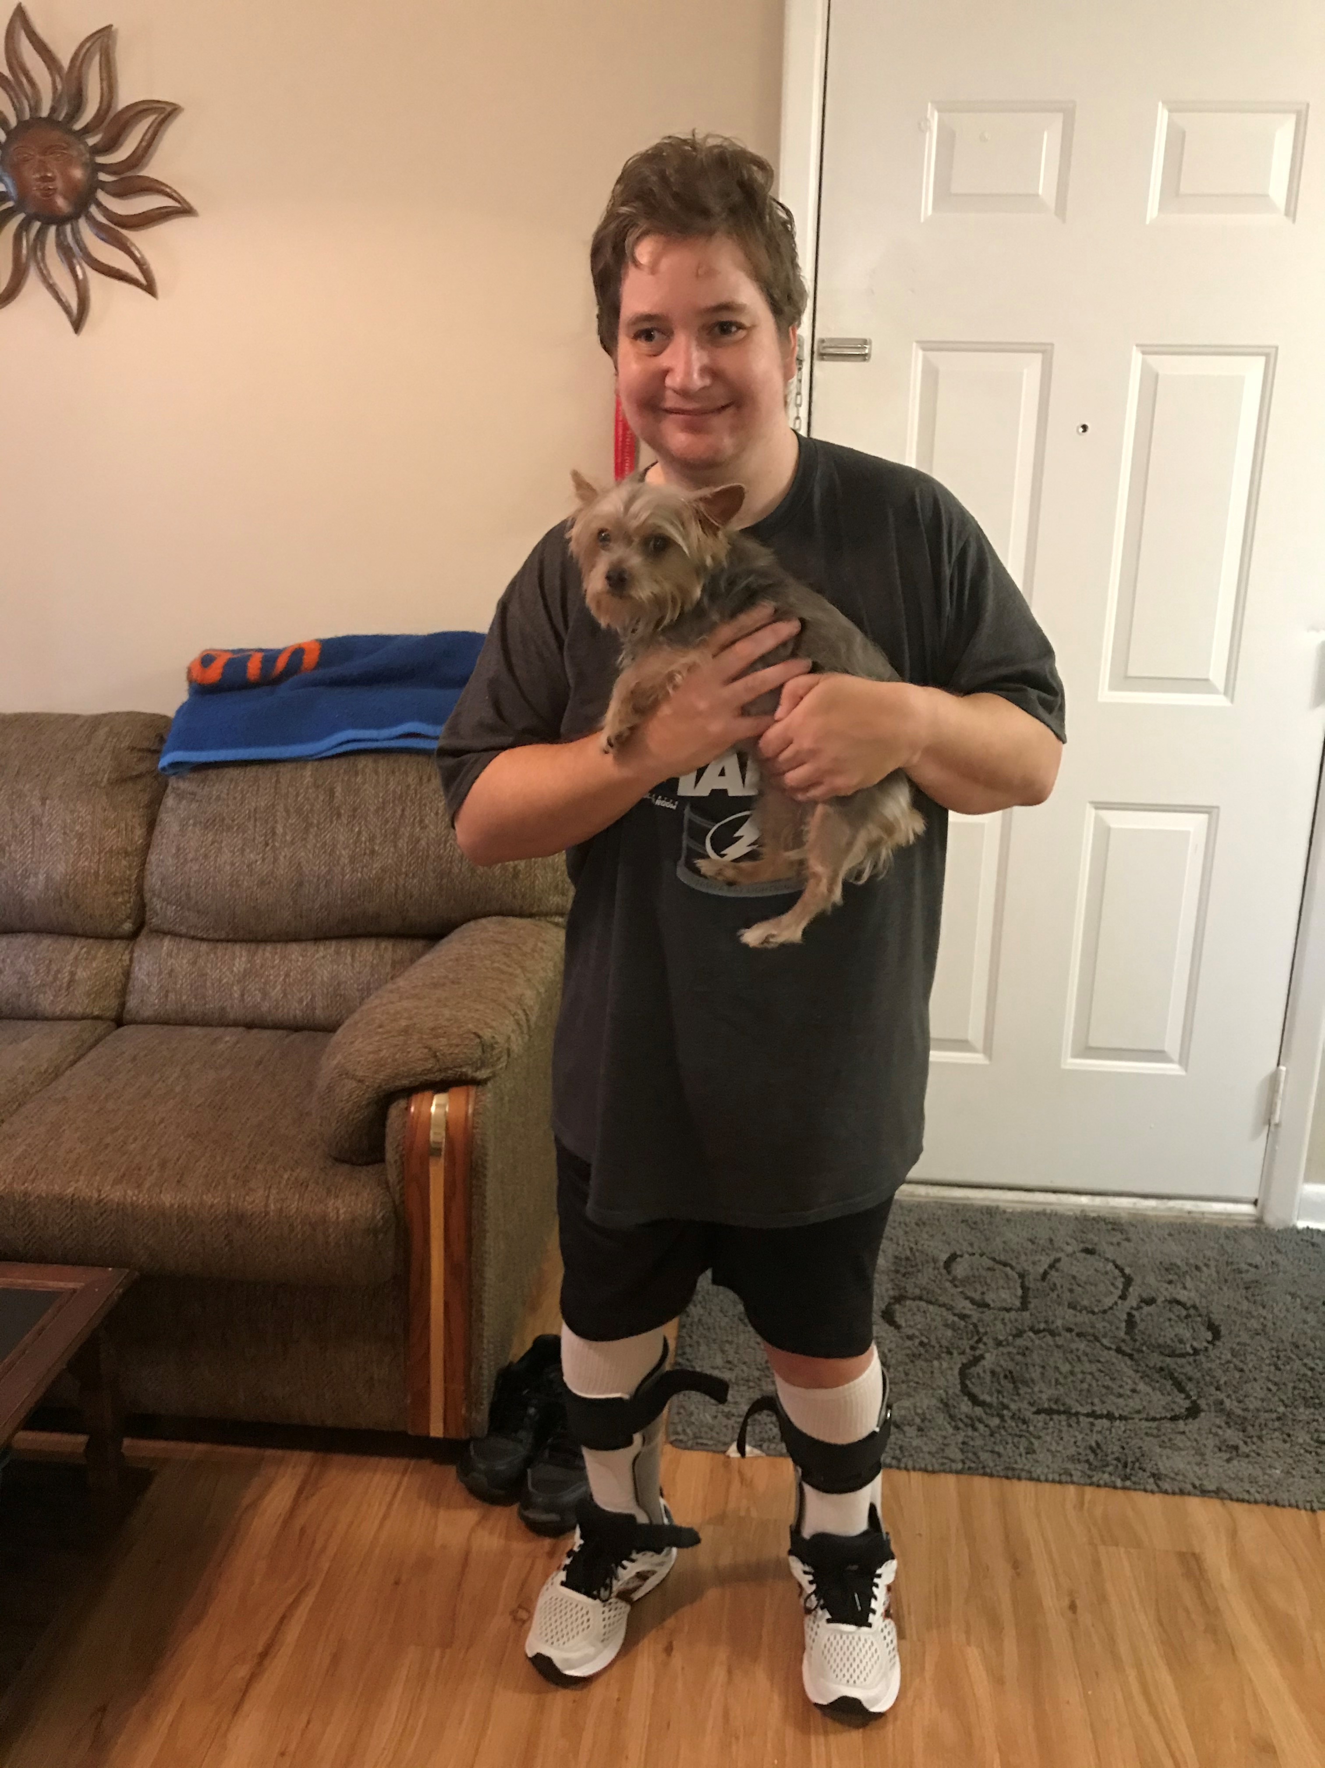
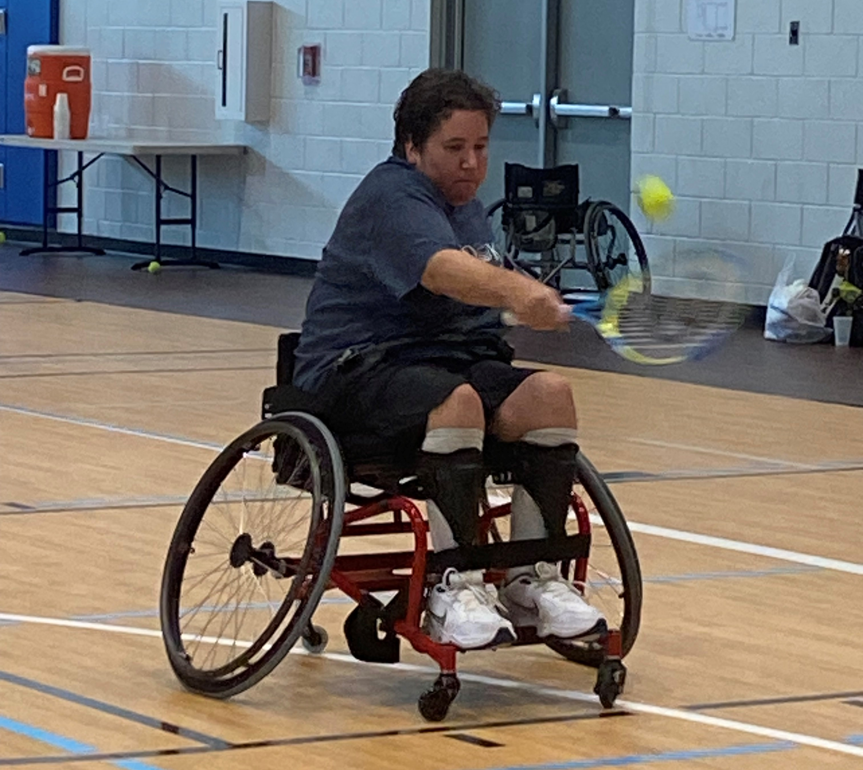
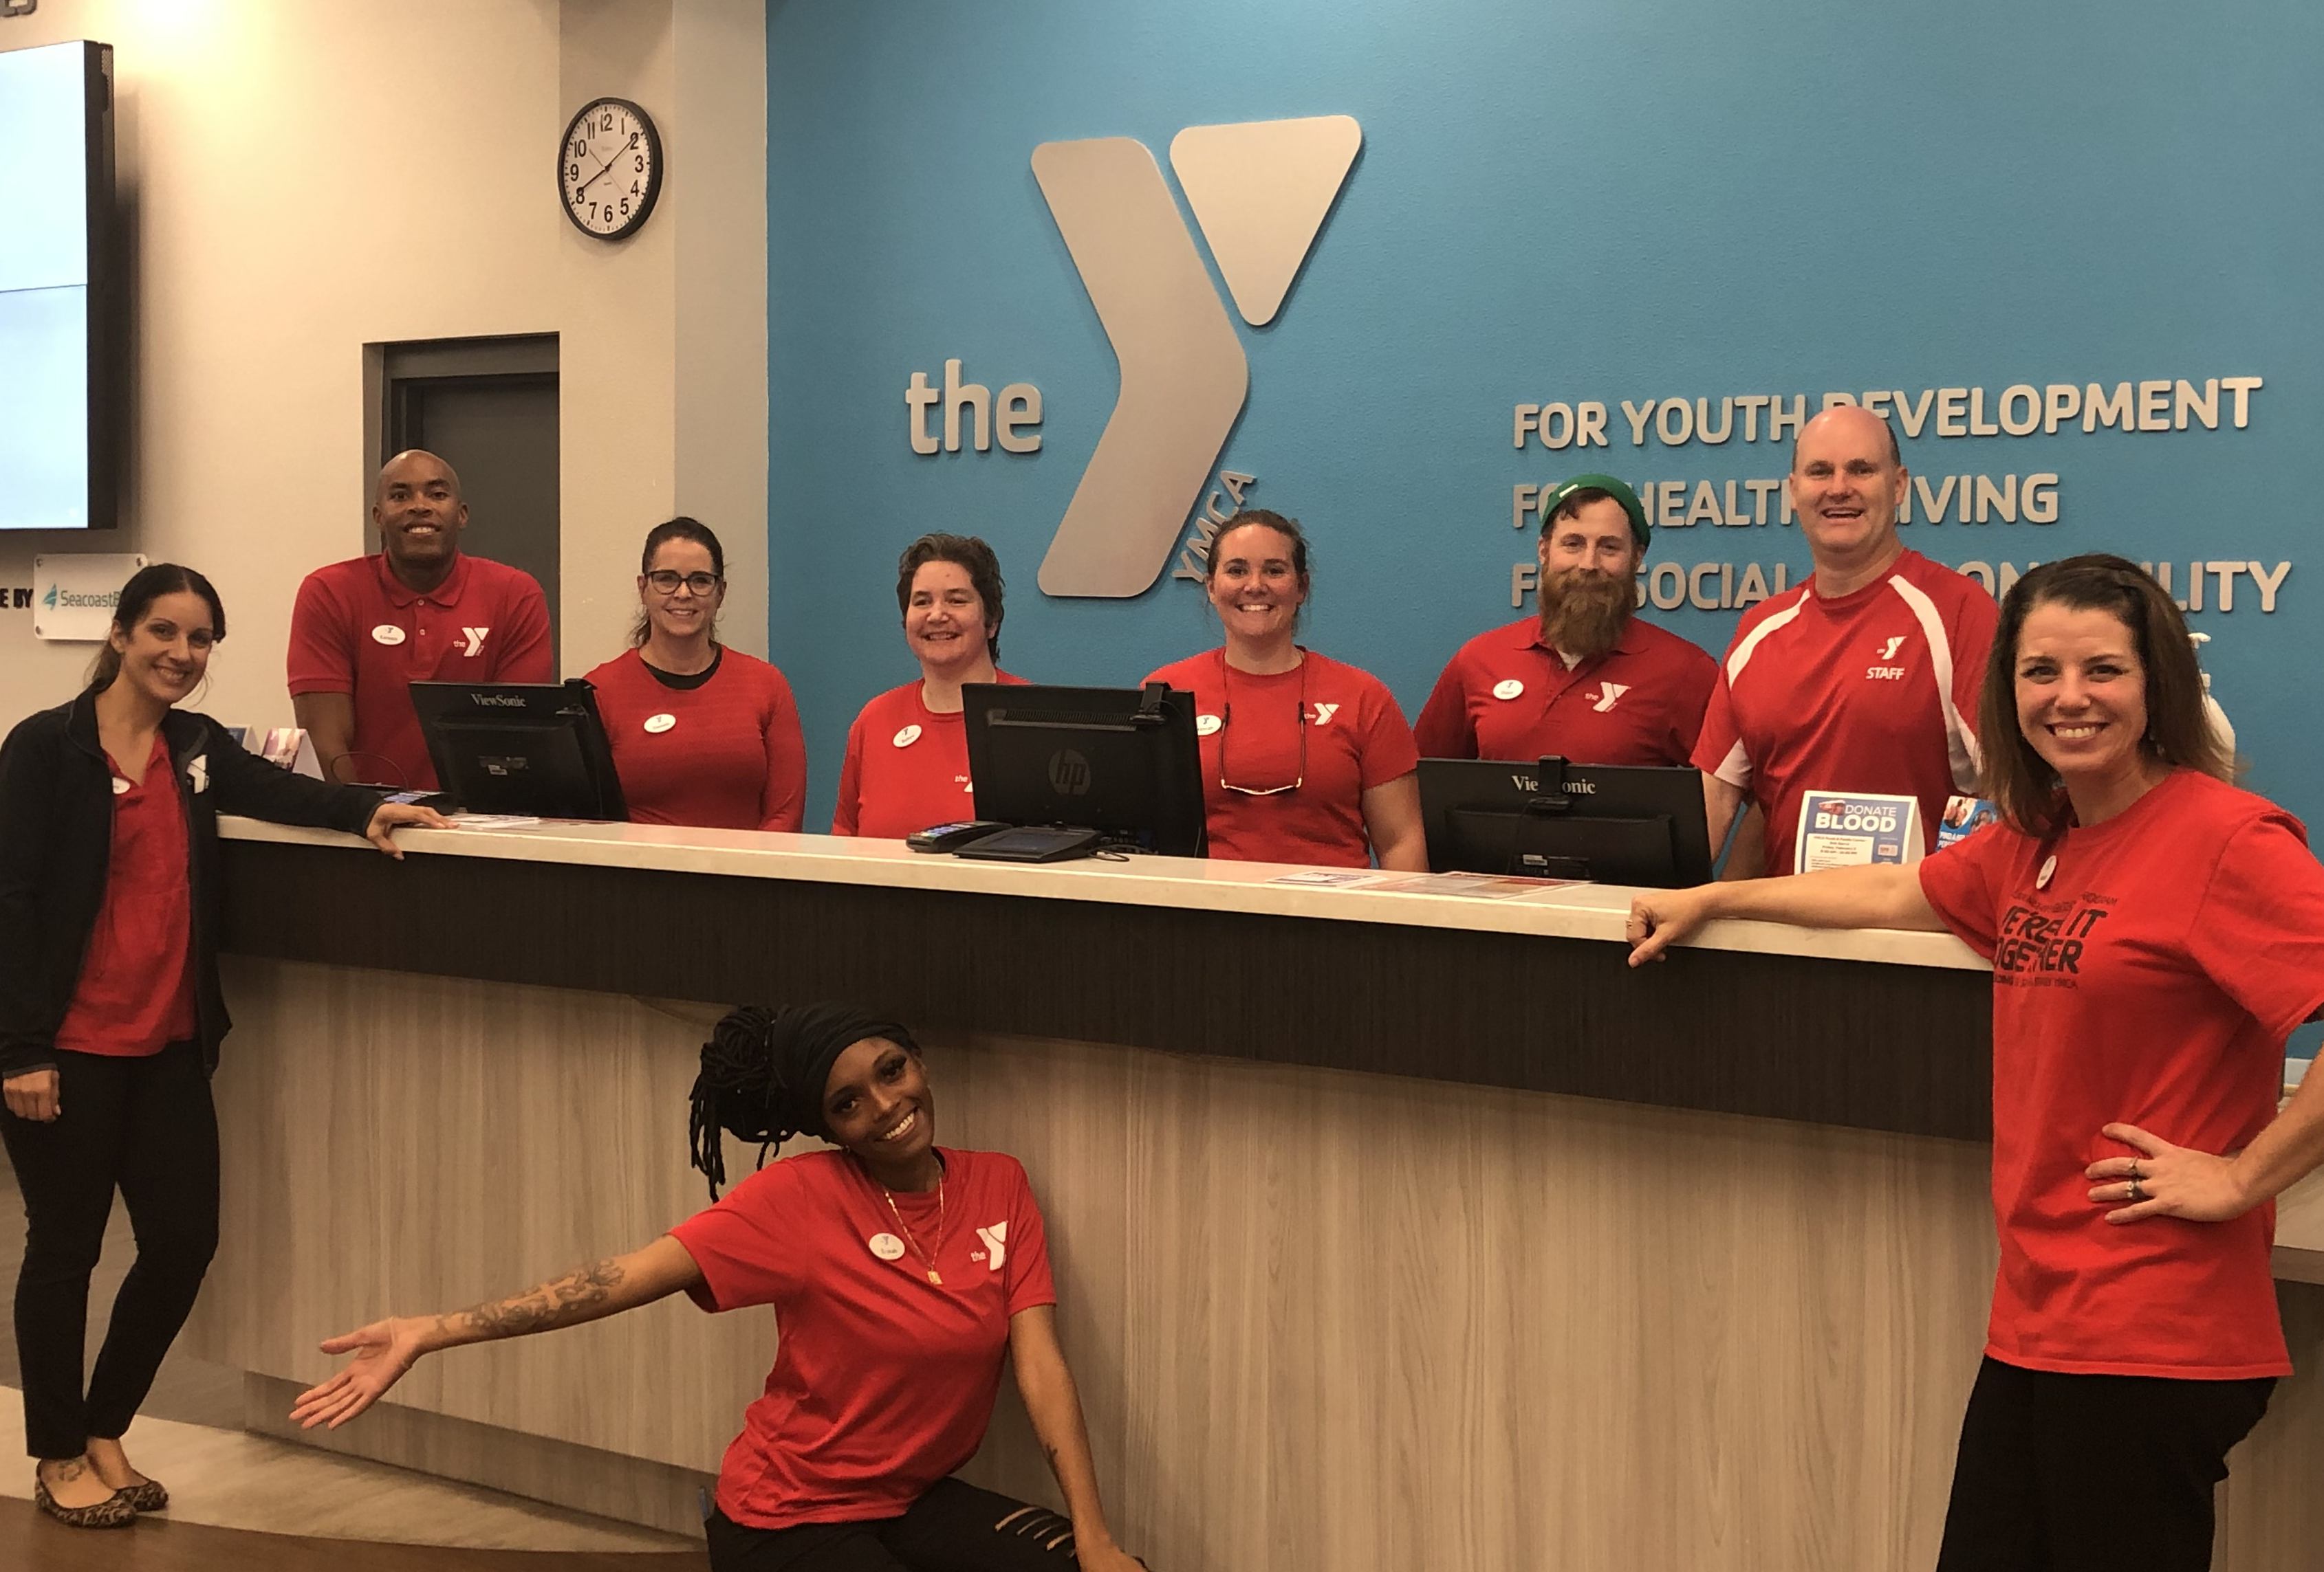
Meet Robyn!

Slide 14
Robyn’s Perspective
What new life celebrations and challenges have I had this year?
How do I keep a long-term relationship with my providers that is healthy and balanced?
What should I do if I believe or suspect that there is a discrepancy in an agency provider’s record of services provided to me?

Slide 15
Robyn’s Perspective
How do I help my employer understand the role of my provider in my success?
How do I facilitate and educate on the power of inclusion in the workplace?

Slide 16
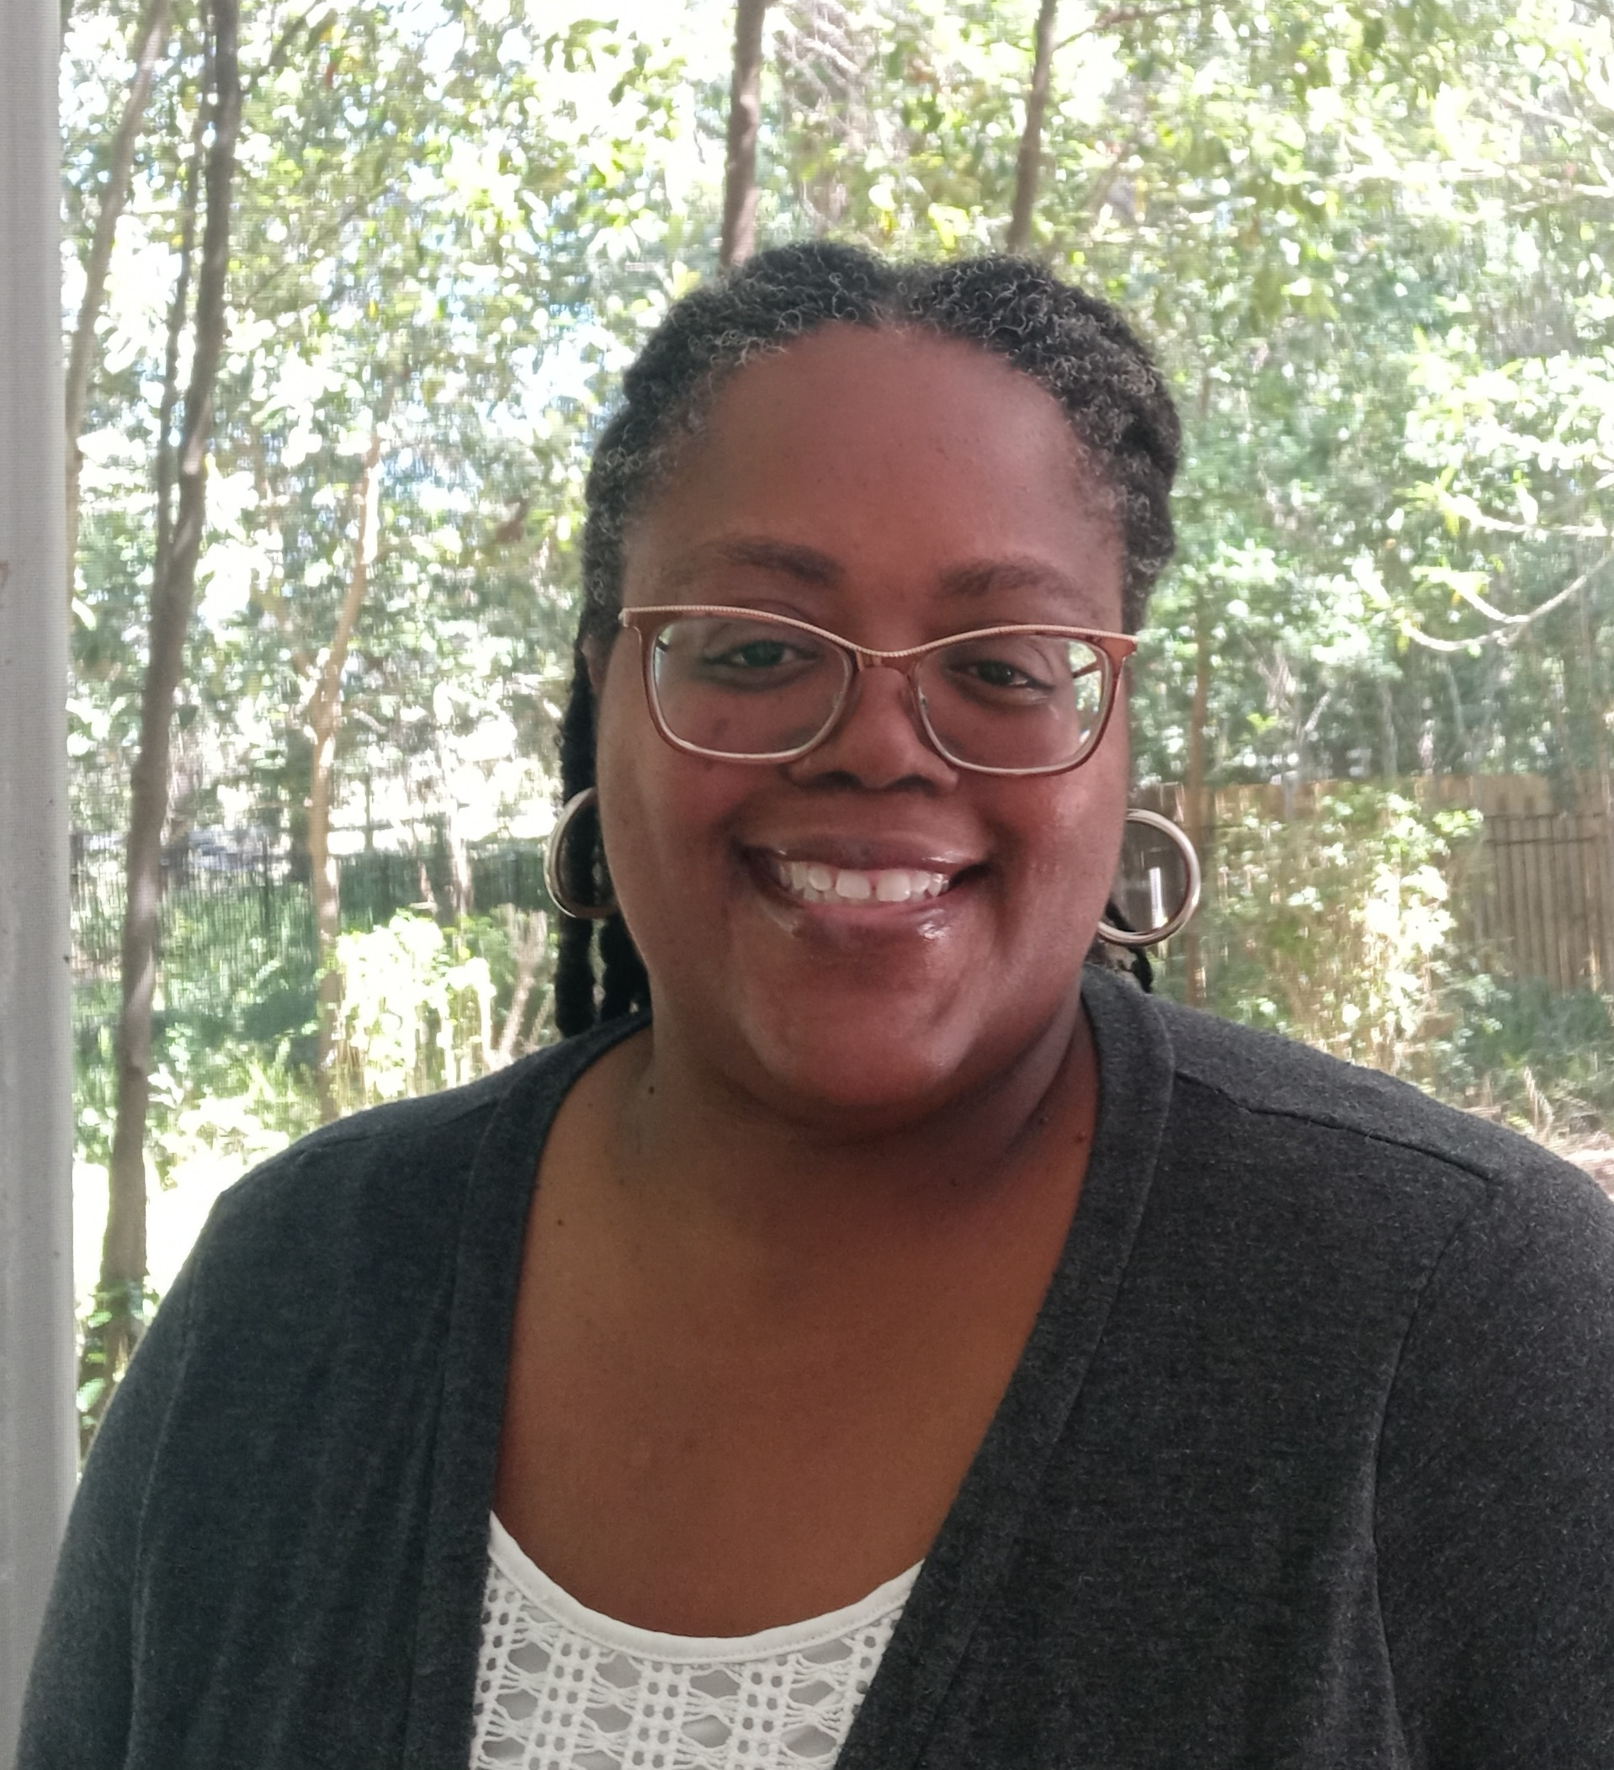
Meet Nichole!
Nichole Dawkins
Chief Executive Officer/Qualified Organization Owner
Waiver Support Coordinator Supervisor
CDC+ Consultant Supervisor

Slide 17
Nichole’s Perspective
How do I manage my role as a WSC and CDC+ Consultant?
What do these roles have in common and what is different?
How does the WSC/CDC+ Consultant help monitor providers and client well-being?

Slide 18
Nichole’s Perspective
How do I ensure an understanding of CDC+ processes, documentation, and other requirements?
How do I develop relationships in the community to assist my clients?
How do I help my clients find and utilize community resources in addition to waiver providers?

Slide 19
Getting Connected
Family Care Council
http://www.fccflorida.org/
Florida Self-Advocates Network’D (FL SAND)
http://flsand.org/
Subscribe to APD news
http://apdcares.org/

Slide 20
Let’s Not Forget…
Self-advocacy – it's your decision!
Know the rules of the program
Your WSC should help YOU
How to find providers
Use community resources

Slide 21
APD Resources
iBudget Florida
http://ibudgetflorida.org
Consumer-Directed Care Plus (CDC+)
https://apd.myflorida.com/cdcplus/
Florida Navigator
https://navigator.apd.myflorida.com/
APD Resource Directory
http://resourcedirectory.apd.myflorida.com/resourcedirectory/

Slide 22
Contact Information
Sara Canali, Self-advocate Email: canalissi25@gmail.com
Rebecca Crosby, Self-advocate Email: rebeccarcrosby@gmail.com
Robyn Stawski, Self-advocate Email: robyn.stawski@gmail.com
Natalie Jean, Self-advocate and APD Ombudsman Email: natalie.jean@apdcares.org Office Phone: 850-414-6666

Slide 23
Thank You!

